Slide 1

Taste of Chicago
Machine Learning

Slide 2
Exploring the taste is important for a new restaurant
Food Diversity is an important part of an ethnically diverse metropolis.
This will reveal if food has any relationship with the diversity of a neighborhood.
It can be utilized by a new food vendor who is willing to open his or her restaurant.
The diversity of a neighborhood by leveraging venue data from Foursquare’s ‘Places API’ and ‘k-means clustering’ unsupervised machine learning algorithm. Exploratory Data Analysis (EDA) will help to discover further about the culture and diversity of the neighborhood.

Slide 3
Data Acquisition and Cleaning
Chicago Neighborhood data is acquired by Wikipedia. Link: https://en.wikipedia.org/wiki/List_of_neighborhoods_in_Chicago
Foursquare API, a location data provider, will be used to make RESTful API calls to retrieve data about venues in different neighborhoods. Link: https://developer.foursquare.com/docs
There are 109 different categories of food places available in Chicago.
The number of unique categories is examined, and it is found that there are only 68 of them, as compared to 109 earlier.

Slide 4
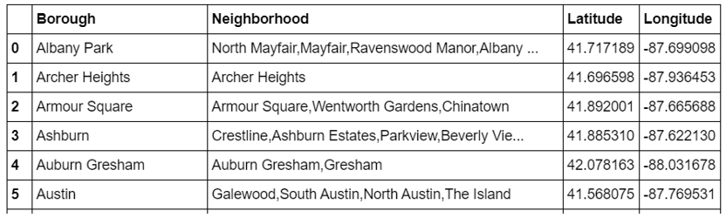
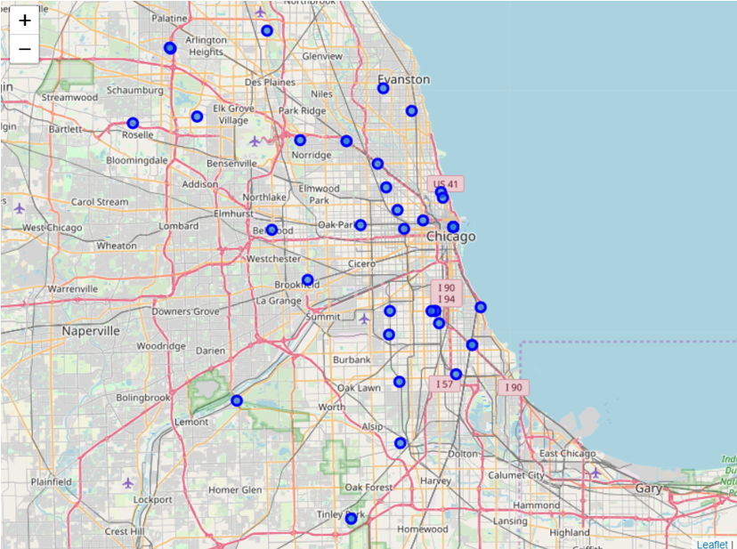
Methodology - 1
We will use Beautiful soup to get the table and create a pandas data frame from there using Wikipedia link
Further, ‘geopy’ library is used to get the latitude and longitude values of Chicago City.
The curated dataframe is then used to visualize by creating a map of Chicago City with neighborhoods superimposed on top.

Slide 5
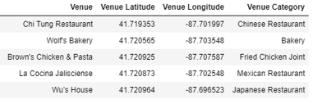
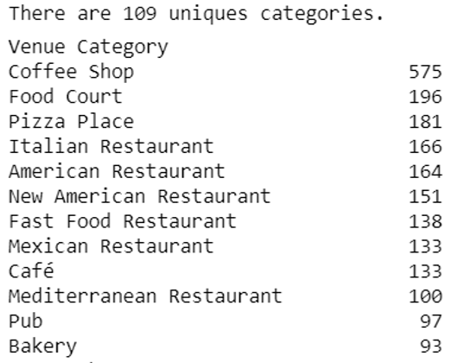
Methodology - 1
The Foursquare API is used to explore the neighborhoods and segment them.
The aim is to segment the neighborhoods of Chicago City with respect to the ‘Food’ in its vicinity, it is further required to fetch this data from all the neighborhoods' venues.
Pickle is a very important and easy-to-use library. It is used to serialize the information retrieved from GET requests, to make a persistent ‘.pkl’ file. This file can later be deserialized to retrieve an exact python object structure.

Slide 6
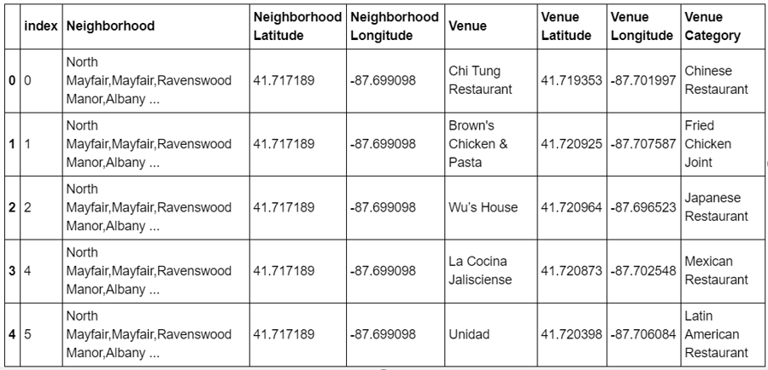
Methodology - 2
It is crucial to understand that the point of interest in the project is to understand the cultural diversity of a neighborhood by clustering it categorically, using the venues’ categories.
It is important to remove all the venues from the ‘dataframe’ which have generalized categories.
Again, the number of unique categories is examined, and it is found that there are only 68 of them, as compared to 109 earlier.

Slide 7
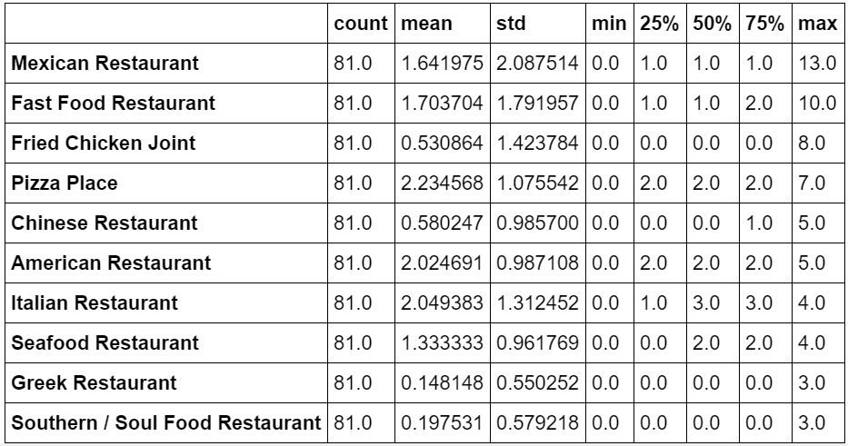
Data Visualization
Let's find out the top 10 food categories in Chicago

Slide 8
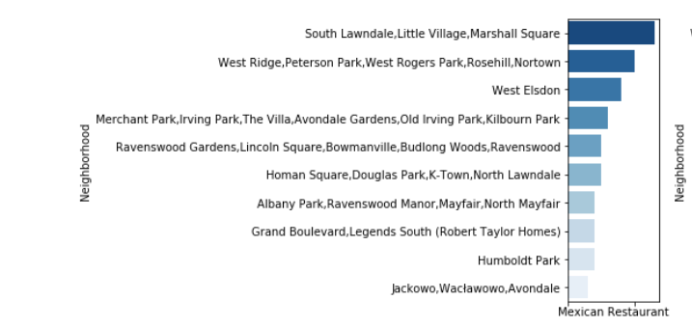
Data Visualization
These top 10 categories are further plotted individually on bar graph using seaborn’ library.

Slide 9
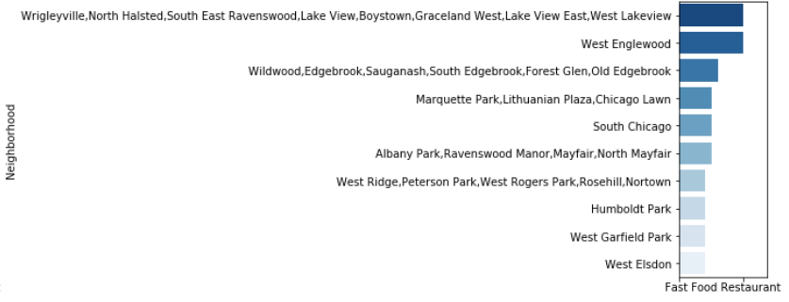
Data Visualization

Slide 10
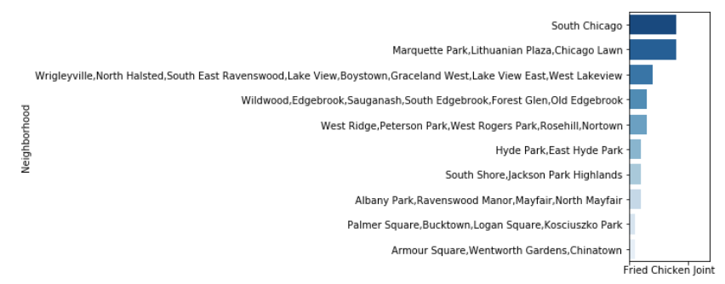
Data Visualization

Slide 11
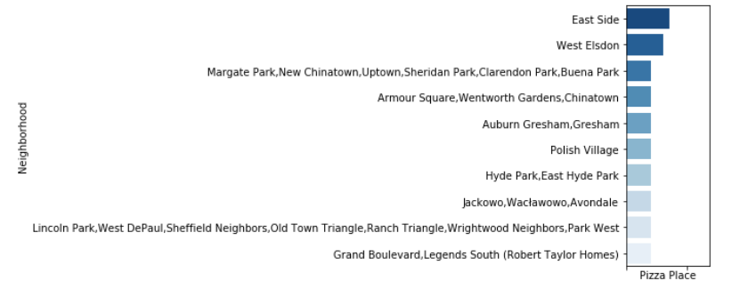
Data Visualization

Slide 12
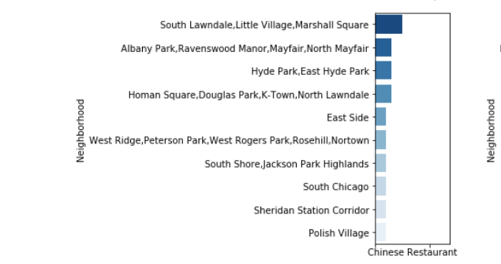
Data Visualization

Slide 13
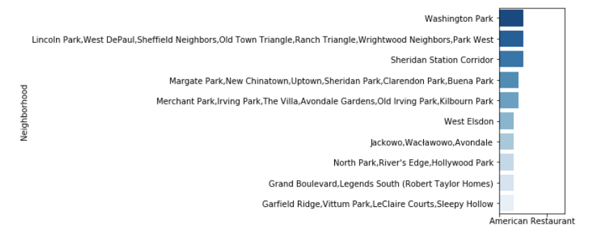
Data Visualization

Slide 14
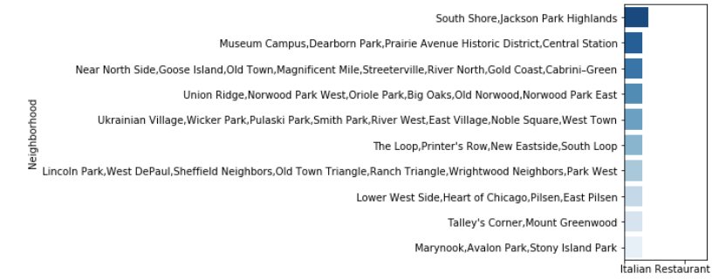
Data Visualization

Slide 15
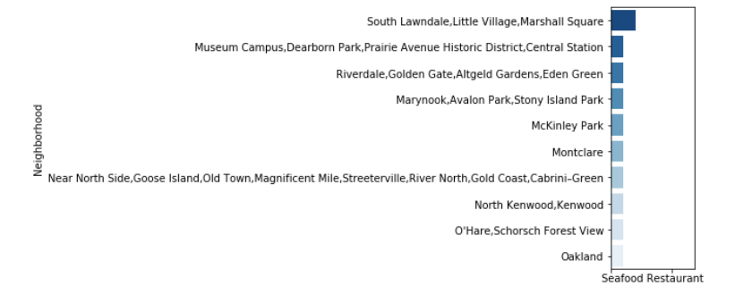
Data Visualization

Slide 16
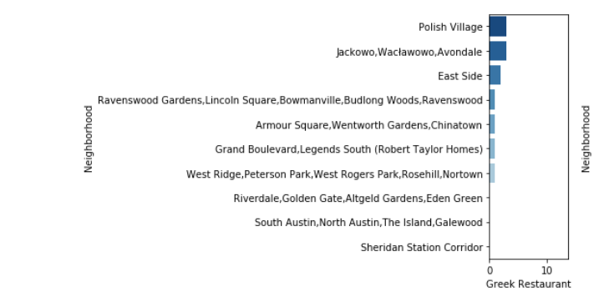
Data Visualization

Slide 17
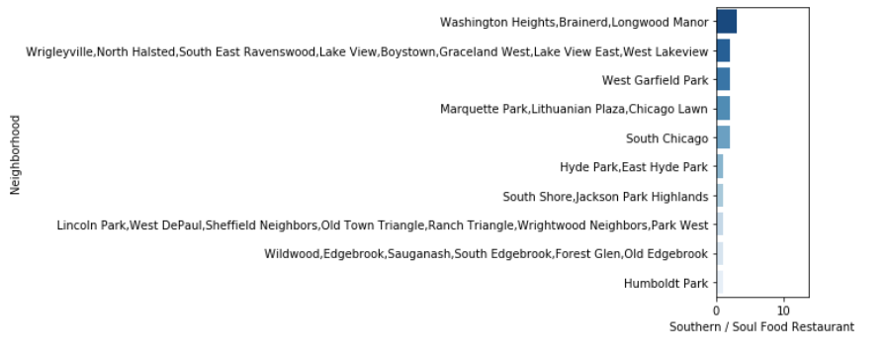
Data Visualization

Slide 18
Machine Learning
‘k-means’ is an unsupervised machine learning algorithm which creates clusters of data points aggregated together because of certain similarities.
The Elbow Method calculates the sum of squared distances of samples to their closest cluster center for different values of ‘k’.
The Silhouette Method measures how similar a point is to its own cluster (cohesion) compared to other clusters (separation).
This algorithm will be used to count neighborhoods for each cluster label for variable cluster size.
It is very important to determine the optimal number of clusters (i.e. k).

Slide 19
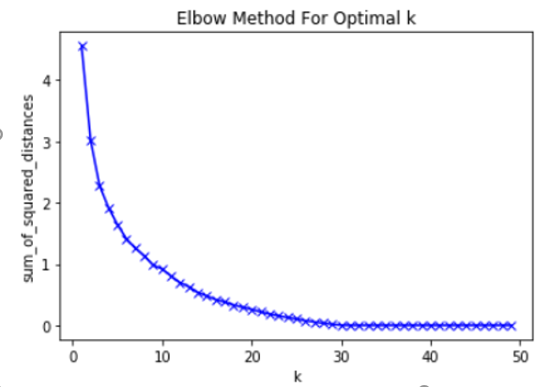
Machine Learning
The Elbow Method
The Elbow Method calculates the sum of squared distances of samples to their closest cluster center for different values of ‘k’.
The optimal number of clusters is the value after which there is no significant decrease in the sum of squared distances.
Elbow method does not give the required result, which happened in this case. As, there is a gradual decrease in the sum of squared distances, optimal number of clusters cannot be determined.

Slide 20
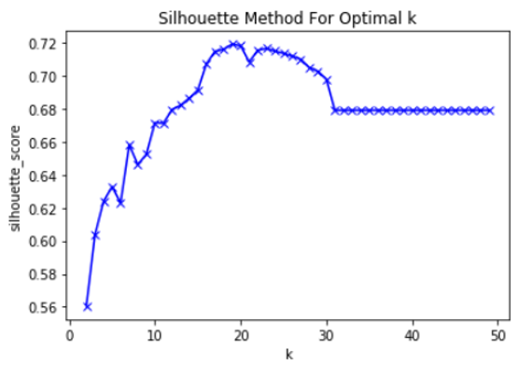
Machine Learning
The Silhouette Method
The Silhouette Method measures how similar a point is to its own cluster (cohesion) compared to other clusters (separation)
There is a peak at k = 6 and k = 8. Four clusters will give a very broad classification of the venues.
So, let’s choose the number of clusters k=8

Slide 21
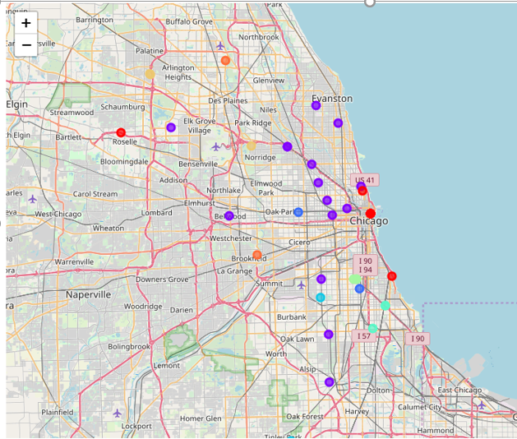
Machine Learning
K-MEANS
The cluster labels curated are added to the dataframe to get the desired results of segmenting the neighborhood based upon the most common venues in its vicinity
The Chicago City’s neighborhoods are visualized by using the python ‘folium’ library.
Following map is generated which shows the desired segmentation of the Chicago’s neighborhoods

Slide 22
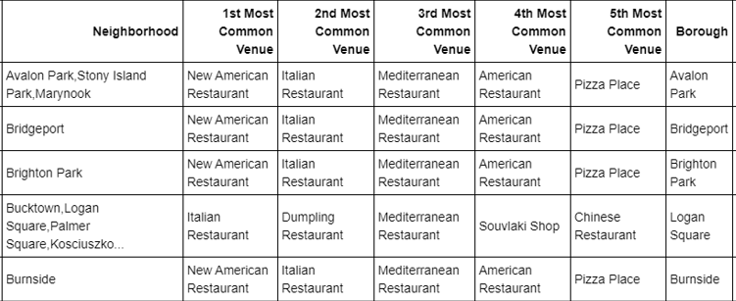
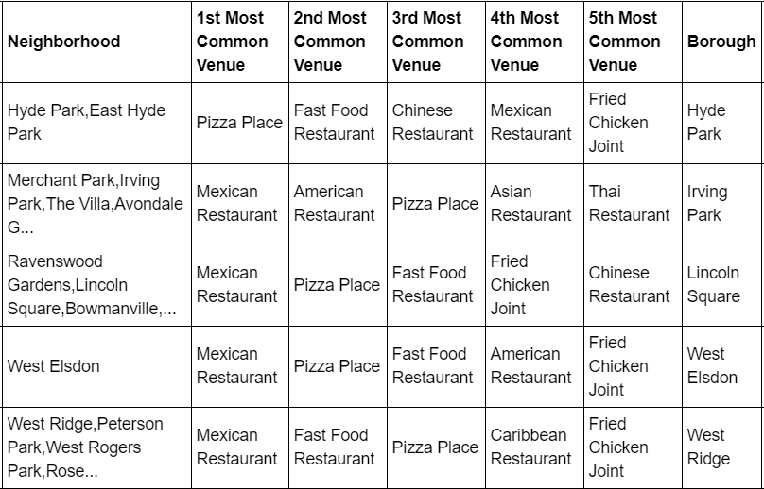
Results
Cluster 0
Cluster 0
Cluster 1

Slide 23
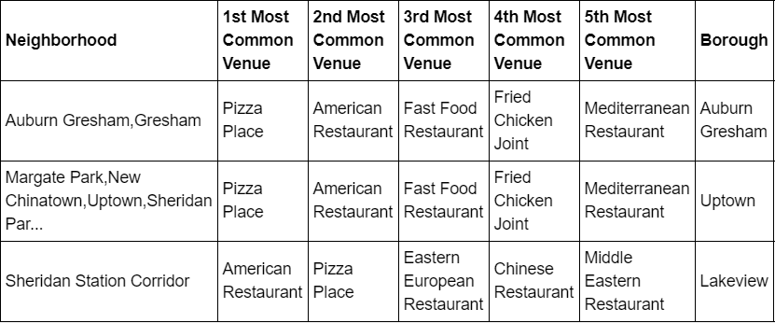
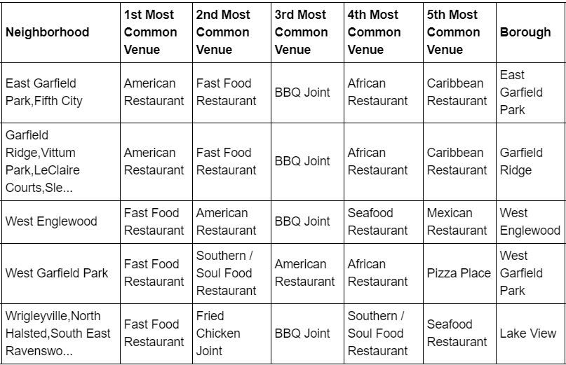
Results
Cluster 2
Cluster
Cluster 3

Slide 24
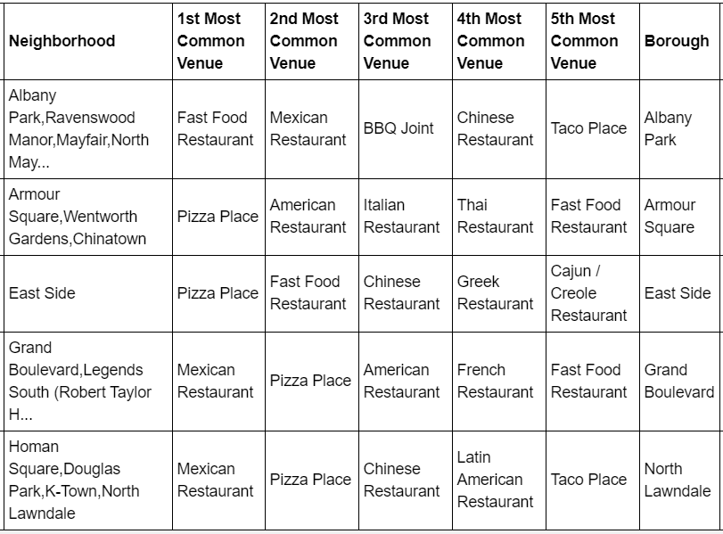
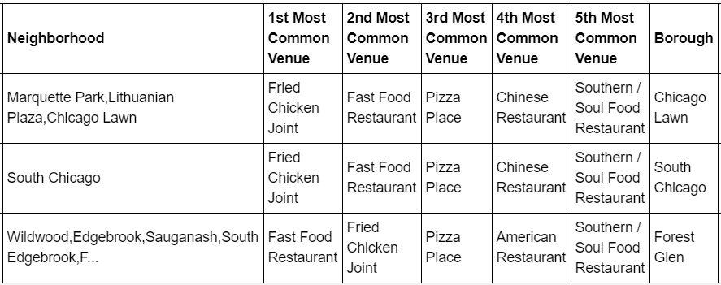
Results
Cluster 4
Cluster
Cluster 5

Slide 25
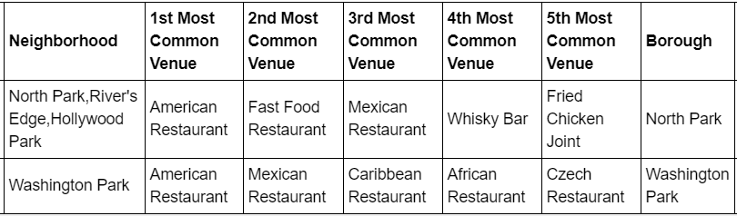
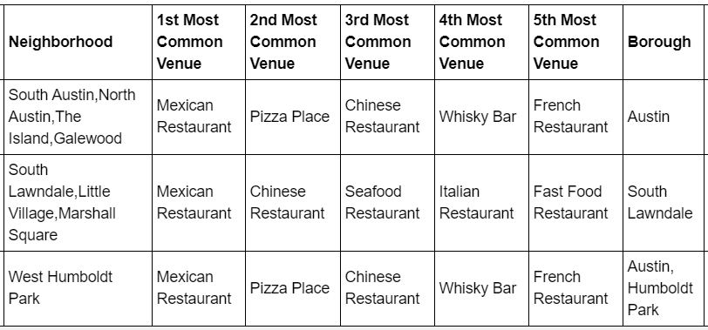
Results
Cluster 6
Cluster
Cluster 7

Slide 26
Discussion
To understand the clusters, three analysis were done, namely:
Count of ‘Borough’
Count of ‘1st Most Common Venue’
Count of ‘2nd Most Common Venue’
Count of Occurrences within the Cluster
Cluster | 1st Most Common Venue | 2nd Most Common Venue | Borough
0 | American Restaurant | Italian Restaurant | Ashburn, Belmont Cragin, Morgan Park, Bridgeport, Brighton Park
1 | Mexican Restaurant | Fast Food Restaurant | Hyde Park, Irving Park, Lincoln Square, West Elsdon, West Ridge
2 | Pizza Place | American Restaurant | Uptown, Auburn Gresham, Lakeview
3 | Fast Food Restaurant | American Restaurant | West Englewood, Lake View, Garfield Ridge, West Garfield Park, East Garfield Park
4 | Pizza Place | Fast Food Restaurant | Albany Park, Armour Square, East Side, Grand Boulevard, North Lawndale
5 | Fried Chicken Joint | Fast Food Restaurant | Chicago Lawn, South Chicago, Forest Glen
6 | American Restaurant | Fast Food Restaurant | North Park, Washington Park
7 | Mexican Restaurant | Pizza Place | Austin, South Lawndale, Humboldt Park

Slide 27
Conclusion
On application of Clustering Algorithm, k-Means or others, to a multi-dimensional dataset, a very inquisitive results can be curated which helps to understand and visualize the data.
The neighborhoods of Chicago City were very briefly segmented into eight clusters and upon analysis it was possible to rename them basis upon the categories of venues in and around that neighborhood.
The results of this project can be improved and made more inquisitive by using a current Chicago City’s dataset along with API platforms which are more interested in Food Venues (like Yelp, etc.)
The scope of this project can be expanded further to understand the dynamics of each neighborhood and suggest a new vendor a profitable location to open his or her food place.

